Slide 1
Surveying the Cyberspace
Cybersecurity 101 Day 2

Slide 2

Class Objectives
By the end of today’s class, you will be able to:
Articulate a clear definition of the CIA Triad and its elements.
Define and contextualize technical terms found in recent cybersecurity trends and reports.
Utilize cybersecurity trend reports to communicate risk patterns.
Conduct and present analysis on a vulnerability, exploit, or threat actor to a non-technical audience using independent research.
‹#›

Slide 3

quick
Let’s do a review!
‹#›
Notes:
Image source: AdobeStock_121721042

Slide 4

Quick Review
Last class, we described cybersecurity as centering on two concepts.
What were they?
Notes:
Image Source: AdobeStock_125741492

Slide 5
Quick Review
Quick Review
The two concepts that cybersecurity is centered on are:
Threat Assessment
Risk Mitigation
‹#›

Slide 6
Quick Review
How would you define these terms?
Threat Assessment
Risk Mitigation
‹#›

Slide 7
Quick Review
Quick Review
Threat Assessment
Structured process of identifying the risks posed to a group or system.
Risk Mitigation
Systematic reduction of the impact and/or the likely occurrence of a negative event.
‹#›

Slide 8

Quick Review
In other words...
Threat Assessment
What Could Happen?
Risk Mitigation
How Do we Handle It?
‹#›
Notes:
Image source: shutterstock_231597421

Slide 9


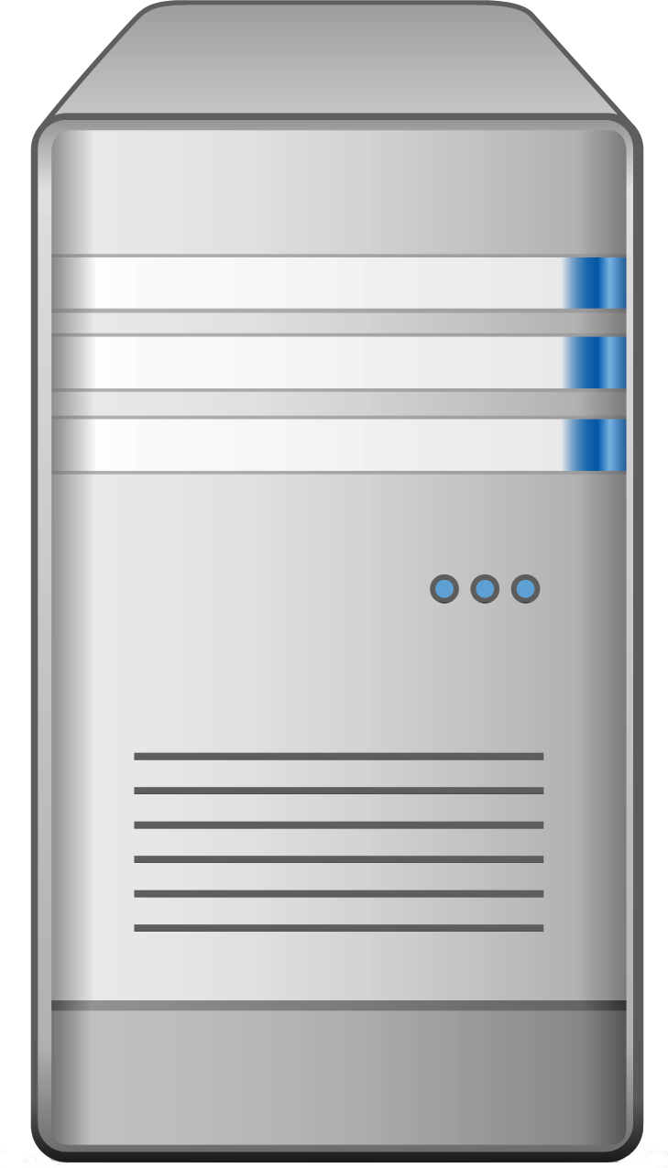

Quick Review
Last class, we talked about a situation in which we were offering advice on a vulnerable login.
Login
Web Login
Server
Data
Which elements of this diagram did we conclude were potential targets?
Users and Admins

Slide 10
Quick Review
All of them!
Login
Web Login
Server
Data
In every case, an attacker could target every node along the chain.
Users and Admins

Slide 11
Quick Review
Name Three User Attacks
Users and Admins

Slide 12
Quick Review
Name Three User Attacks
Social Engineering
Credential Reuse
Malware Attacks
Man in the Middle
Packet Sniffing
Users and Admins
Computer Theft

Slide 13
Quick Review
Name One Website Attack
Login
Web Login

Slide 14
Quick Review
Name One Website Attack
Login
Brute-Force Injection
Code Injection
Session Stealing
Web Login

Slide 15
Quick Review
Name One Server Attack
Server

Slide 16
Quick Review
Name One Server Attack
OS Exploits
Code Injection
Server

Slide 17
Quick Review
Name One Database Attack
Data

Slide 18
Quick Review
Name One Database Attack
Default Credentials
Unpatched Database
Lack of Segregation
Data

Slide 19
Quick Review
User Attacks
Web Attacks
Database Attacks
Social Engineering
Brute-Force Attacks
Default Credentials
Phishing Attacks
Code Injection
Unpatched Database
Credential Reuse
Faulty Sessions
Lack of Segregation
Malware Attacks
Man in the Middle
Server Attacks
Name Three
Risk Mitigation Options
Packet Sniffing
OS Exploit
Computer Theft
Malicious Software

Slide 20
Quick Review
Name Three Risk Mitigation Options
1. Educate all users on dangers of phishing and social engineering.
2. Ensure passwords are truly unique to website (require characters atypical of other websites).
3. Ensure users are using multi-factor authentication (login + phone confirmation).
4. Ensure administrators can only access the network from a secure location (on premises).
5. Ensure passwords used are strong (alphanumeric + symbols).
6. Ensure login fields do not accept any code insertions.
7. Ensure users are immediately signed off upon closing a browser.
8. Ensure all servers are routinely patched against latest known vulnerabilities.
9. Ensure physical access to servers is protected by multiple forms of authentication.
10. Ensure that all data stored in the database is encrypted and cannot be read without additional login information.
11. Ensure that all cloud security platforms follow best practices for security implementation.

Slide 21
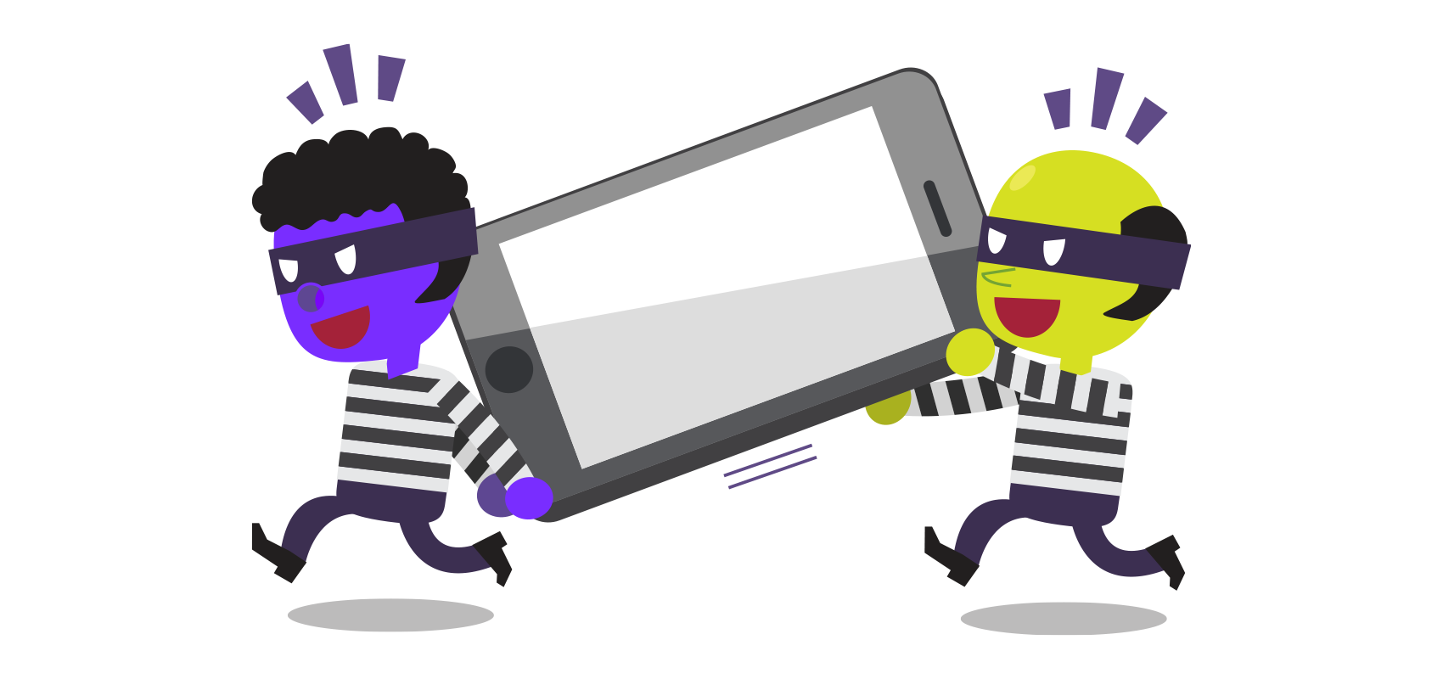
Quick Review
With the person sitting next to you, identify as many exploits possible in the event of a cell phone being stolen.
Hint: Be creative! Think like a hacker.
What is the worst possible damage that could ensue.
Try to do real damage.
Think beyond the value of the phone itself.
Activity: Oh look, a phone!
Suppose last class, two students left their phones unattended at some point.
Notes:
Image source: shutterstock_317022485

Slide 22
Quick Review
Activity Review: Oh look, a phone!
Potential Adverse Event
Cell phone can be wiped and re-sold.
Cell phone memory can be harvested. Photos and sensitive material could be used for blackmail.
Credentials for email and social media accounts could be used to extract financial gain.
Installed applications could be used to make purchases.
Malware software could be directly installed to track future activity.
Contacts on your phone could be socially engineered into providing monetary value.
Your phone could be used to conduct illegal activity.
Your identity could be stolen.
Notes:
Image source: shutterstock_317022485

Slide 23
The CIA Triad

Slide 24

The InfoSec Bible: The CIA Triad
1
Availability
2
Integrity
INFORMATION
SECURITY
3
Confidentiality
Notes:
Image source: shutterstock_708213337 (shield)

Slide 25

Availability:
The quality of being able to be used or obtained.
Availability concerns occur when operating systems, equipment, and data are not functioning correctly, thus limiting accessibility to those who need it.
Examples of availability attacks include: hackers taking down a web-connected generator and disabling a critical power supply; using a denial of service attack to bring down a financial service provider’s website, making it impossible for clients to make transactions.
Creating regular backups of data is one way to maintain availability.
1
Availability

Slide 26
Integrity:
The quality of being honest, whole, or undivided.
The integrity of information refers to protecting information from being modified by unauthorized parties.
Examples of integrity attacks include: intercepting money transfers and changing the dollar amount in “insignificant” ways to allow for the excess to be siphoned off; altering the grades at a university to be better or worse.
Integrity attacks can be avoided by instilling
a secure hashing algorithm and process
when transferring data to ensure it
wasn’t tampered in transit.
2
Integrity

Slide 27
Confidentiality:
The state of keeping secret or private.
Confidentiality ensures sensitive information does not reach unauthorized people.
Examples of confidentiality attacks include: uploading private photos and communications onto a forum; having credit card numbers exposed online.
Confidentiality comes down to the principle of “need to know”. Data or information should only be made available to those who need access to it.
Confidentiality is enforced through measures
like encryption, authentication, etc.
3
Confidentiality

Slide 28
Activity: Defending the CIA Triad
In this activity, you will analyze a variety of brief security scenarios and identify which element of the CIA Triad (Confidentiality, Integrity, Availability) each situation is concerned with.
Scenarios sent by Instructor.
12 Minutes

Slide 29
Activity Instructions: Defend the CIA Triad
A hospital only allows authorized healthcare personnel within one department access to patient Personal Identifiable Information. When employees move to another department, that access is revoked.
A technology firm maintains an alternate site that is running 24/7, and operations can be moved to this location in the event of a major disaster.
Employees need to have key cards in order to enter their company offices.
A company hashes their data files in order to monitor whether information has been tampered with.
Only authorized personnel at a company have write access to certain files. All other employees have only read access to these files.
A company employs redundant servers, which means that these systems are duplicated, and in the event of a malfunction, one server will fail over to other.
A company's network infrastructure uses load balancers which will distribute the "load" of tasks such as file requests and data routing to a variety of servers, thereby ensuring that no single device is overburdened.
A hacker uses a man-in-the-middle attack to intercept wireless traffic from users.
A hacker was able to crack a hashed message and change its contents.
A hacker launched a DDoS attack which flooded a website with unwanted traffic from a number of computers and took the site offline.

Slide 31
Activity Instructions: Defend the CIA Triad
A hospital only allows authorized healthcare personnel within one department access to patient Personal Identifiable Information. When employees move to another department, that access is revoked.
A technology firm maintains an alternate site that is running 24/7, and operations can be moved to this location in the event of a major disaster.
Employees need to have key cards in order to enter their company offices.
A company hashes their data files in order to monitor whether information has been tampered with.
Only authorized personnel at a company have write access to certain files. All other employees have only read access to these files.

Slide 32
Activity Instructions: Defend the CIA Triad
A hospital only allows authorized healthcare personnel within one department access to patient Personal Identifiable Information. When employees move to another department, that access is revoked.
Confidentiality
A technology firm maintains an alternate site that is running 24/7, and operations can be moved to this location in the event of a major disaster.
Employees need to have key cards in order to enter their company offices.
A company hashes their data files in order to monitor whether information has been tampered with.
Only authorized personnel at a company have write access to certain files. All other employees have only read access to these files.

Slide 33
Activity Instructions: Defend the CIA Triad
A hospital only allows authorized healthcare personnel within one department access to patient Personal Identifiable Information. When employees move to another department, that access is revoked.
Confidentiality
A technology firm maintains an alternate site that is running 24/7, and operations can be moved to this location in the event of a major disaster.
Availability
Employees need to have key cards in order to enter their company offices.
A company hashes their data files in order to monitor whether information has been tampered with.
Only authorized personnel at a company have write access to certain files. All other employees have only read access to these files.

Slide 34
Activity Instructions: Defend the CIA Triad
A hospital only allows authorized healthcare personnel within one department access to patient Personal Identifiable Information. When employees move to another department, that access is revoked.
Confidentiality
A technology firm maintains an alternate site that is running 24/7, and operations can be moved to this location in the event of a major disaster.
Availability
Employees need to have key cards in order to enter their company offices.
Confidentiality
A company hashes their data files in order to monitor whether information has been tampered with.
Only authorized personnel at a company have write access to certain files. All other employees have only read access to these files.

Slide 35
Activity Instructions: Defend the CIA Triad
A hospital only allows authorized healthcare personnel within one department access to patient Personal Identifiable Information. When employees move to another department, that access is revoked.
Confidentiality
A technology firm maintains an alternate site that is running 24/7, and operations can be moved to this location in the event of a major disaster.
Availability
Employees need to have key cards in order to enter their company offices.
Confidentiality
A company hashes their data files in order to monitor whether information has been tampered with.
Integrity
Only authorized personnel at a company have write access to certain files. All other employees have only read access to these files.

Slide 36
Activity Instructions: Defend the CIA Triad
A hospital only allows authorized healthcare personnel within one department access to patient Personal Identifiable Information. When employees move to another department, that access is revoked.
Confidentiality
A technology firm maintains an alternate site that is running 24/7, and operations can be moved to this location in the event of a major disaster.
Availability
Employees need to have key cards in order to enter their company offices.
Confidentiality
A company hashes their data files in order to monitor whether information has been tampered with.
Integrity
Only authorized personnel at a company have write access to certain files. All other employees have only read access to these files.
Confidentiality

Slide 37
Activity Instructions: Defend the CIA Triad
A company employs redundant servers, which means that these systems are duplicated, and in the event of a malfunction, one server will fail over to other.
A company's network infrastructure uses load balancers which will distribute the "load" of tasks such as file requests and data routing to a variety of servers, thereby ensuring that no single device is overburdened.
A hacker uses a man-in-the-middle attack to intercept wireless traffic from users.
A hacker was able to crack a hashed message and change its contents.
A hacker launched a DDoS attack which flooded a website with unwanted traffic from a number of computers and took the site offline.

Slide 38
Activity Instructions: Defend the CIA Triad
A company employs redundant servers, which means that these systems are duplicated, and in the event of a malfunction, one server will fail over to other.
Availability
A company's network infrastructure uses load balancers which will distribute the "load" of tasks such as file requests and data routing to a variety of servers, thereby ensuring that no single device is overburdened.
A hacker uses a man-in-the-middle attack to intercept wireless traffic from users.
A hacker was able to crack a hashed message and change its contents.
A hacker launched a DDoS attack which flooded a website with unwanted traffic from a number of computers and took the site offline.

Slide 39
Activity Instructions: Defend the CIA Triad
A company employs redundant servers, which means that these systems are duplicated, and in the event of a malfunction, one server will fail over to other.
Availability
A company's network infrastructure uses load balancers which will distribute the "load" of tasks such as file requests and data routing to a variety of servers, thereby ensuring that no single device is overburdened.
Availability
A hacker uses a man-in-the-middle attack to intercept wireless traffic from users.
A hacker was able to crack a hashed message and change its contents.
A hacker launched a DDoS attack which flooded a website with unwanted traffic from a number of computers and took the site offline.

Slide 40
Activity Instructions: Defend the CIA Triad
A company employs redundant servers, which means that these systems are duplicated, and in the event of a malfunction, one server will fail over to other.
Availability
A company's network infrastructure uses load balancers which will distribute the "load" of tasks such as file requests and data routing to a variety of servers, thereby ensuring that no single device is overburdened.
Availability
A hacker uses a man-in-the-middle attack to intercept wireless traffic from users.
Confidentiality
A hacker was able to crack a hashed message and change its contents.
A hacker launched a DDoS attack which flooded a website with unwanted traffic from a number of computers and took the site offline.

Slide 41
Activity Instructions: Defend the CIA Triad
A company employs redundant servers, which means that these systems are duplicated, and in the event of a malfunction, one server will fail over to other.
Availability
A company's network infrastructure uses load balancers which will distribute the "load" of tasks such as file requests and data routing to a variety of servers, thereby ensuring that no single device is overburdened.
Availability
A hacker uses a man-in-the-middle attack to intercept wireless traffic from users.
Confidentiality
A hacker was able to crack a hashed message and change its contents.
Integrity
A hacker launched a DDoS attack which flooded a website with unwanted traffic from a number of computers and took the site offline.

Slide 42
Activity Instructions: Defend the CIA Triad
A company employs redundant servers, which means that these systems are duplicated, and in the event of a malfunction, one server will fail over to other.
Availability
A company's network infrastructure uses load balancers which will distribute the "load" of tasks such as file requests and data routing to a variety of servers, thereby ensuring that no single device is overburdened.
Availability
A hacker uses a man-in-the-middle attack to intercept wireless traffic from users.
Confidentiality
A hacker was able to crack a hashed message and change its contents.
Integrity
A hacker launched a DDoS attack which flooded a website with unwanted traffic from a number of computers and took the site offline.
Availability

Slide 43
Threat Landscape

Slide 44
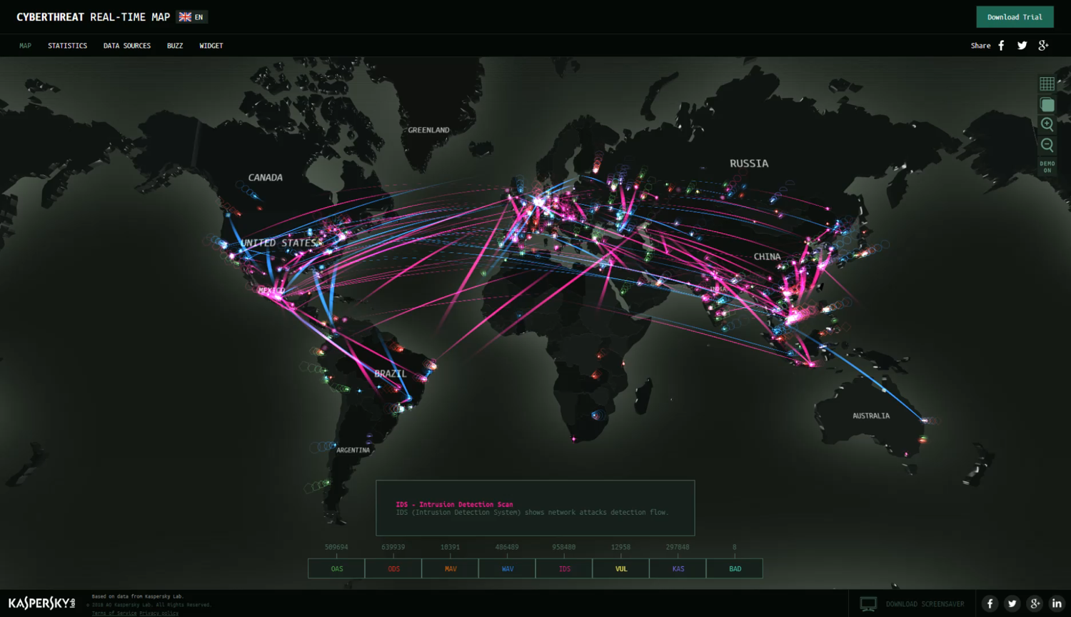
Cyber Attack Maps (Kaspersky)
Threat maps visualize the current cybersecurity landscape, providing a great overview of “real-time” security threats.
Notes:
Screengrab: from https://cybermap.kaspersky.com/

Slide 45
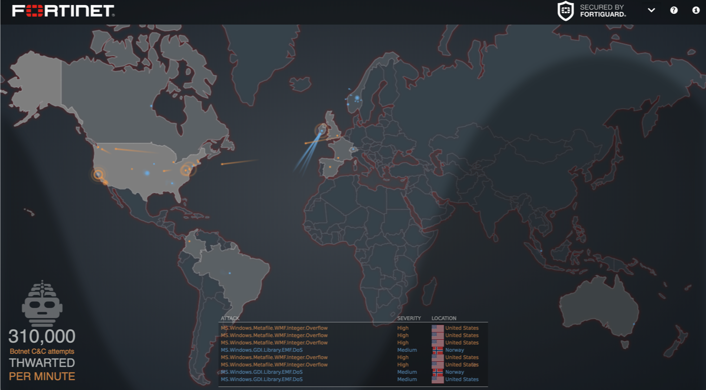
Cyber Attack Maps (Fortinet)
Threat maps visualize the current cybersecurity landscape, providing a great overview of “real-time” security threats.
‹#›
Notes:
Image Source: Screen grab from https://threatmap.fortiguard.com/

Slide 46
Activity: Kaspersky + Fortinet Map Exploration
In this activity, you will navigate through Kaspersky and Fortinet maps and uncover what is displayed, what terminology arises, and any visible trends.
10 minutes

Slide 47
Activity Instructions: Kaspersky + Fortinet Map Exploration
Suggested Time: 10 Minutes
Instructions:
Spend a few minutes playing around with the Kaspersky and Fortinet Threat Maps: Link: https://threatmap.fortiguard.com/
https://cybermap.kaspersky.com/
While on these websites, answer the following questions:
What exactly are these websites showing?
Are there any terms used on these websites that you are unfamiliar with? Find and define at least three.
Are there any trends that stick out to you? Look for at least two.

Slide 48
Activity: Report Analysis

Slide 49
Threat Research

Slide 50

Cybersecurity and Soft Skills
While this program focuses primarily on the hard skills needed in cybersecurity, soft skills such as collaboration and communication are also a huge component.
Notes:
Image source: shutterstock_1055364239

Slide 51
Cybersecurity and Soft Skills
Cybersecurity often involves communicating highly technical information to a non-technical audience.
Developing your presentation skills is another critical skill. This includes public speaking, creating compelling slide visuals, and crafting a narrative for your information.
Being able to speak a common language with your audience and adjusting your message and language depending on the technical background of your audience is equally important.
Therefore, in the next activity, we will work in groups of 3-4 to develop a brief presentation of a threat, vulnerability, or exploit.
We will get started on these presentations today and then present them in the next class.

Slide 52
Activity: Threat Research
In this activity, you will form groups of 3 or 4 to research an assigned vulnerability, exploit, or threat actor.
(Instructions sent via Slack.)
40 Minutes

Slide 53
Activity Instructions: Threat Research
Suggested Time: 40 Minutes
Instructions:
Form groups of three or four. You will be assigned a vulnerability, exploit, or threat actor.
Your task is to: Prepare a 5-10 minute presentation that provides an overview of the topic. Focus on answering the following question:
What is or was the exploit, vulnerability, or threat actor?
What damage has it done?
What steps have or can be taken to mitigate the damage?
Notes:
While you may be new to the field challenge yourself to “become the expert.” A huge part of being a security professional is getting up to speed quickly on technical situations using research.
For those uncomfortable about the idea of presenting, challenge yourself to treat this as a safe place. Becoming a confident speaker is an important part of being a cybersecurity consultant that people can trust.

Slide 54
Activity Instructions: Threat Research
Suggested Time: 40 Minutes
Instructions:
You will continue working outside of class and create a slide presentation.
Presentations will be given in the next class.
This is an opportunity to gain valuable research skills, security exposure, and hone your communication skills.

Slide 55

Threat Research Presentations
What is this threat? (or What was it?)
What damage has it done?
What steps can or have been taken to mitigate?
Emotet | Zealot Campaign | Digmine | Triton | BadRabbit
Disakil | Finfisher | Thrip | Orangeworm | Ploutus ATM Malware
Gh0st RAT | Trickbot | Necurs | BlankSlate | CVE-20170199
Vulnerability, Exploits, and Threat Actors
‹#›

Slide 56
Activity: Threat Research

Slide 57

Notes:
Image source: AdobeStock_56885471

Slide 58
Cybersecurity Domains

Slide 59
Providing advice on getting started in digital security is similar to providing advice on
getting started in medicine.
If you ask a neurosurgeon, he or she may propose some sort of experiment with dead frog legs and batteries. If you ask a dermatologist, you might get advice on protection from the sun whenever you go outside. Asking a “security person” will likewise result in many different responses, depending on the individual’s background and tastes.
’
’
’
’
—Tao Security’s Richard Bejtlich on entering the cybersecurity field

Slide 60
Cybersecurity Domains
Physical Security
Security Architecture
Framework and Standard
Risk Assessment
Career Development
Cybersecurity Domains
Security Operation
Governance
User Education
Threat Intelligence

Slide 61
Cybersecurity Domains
Security Architecture: Security design that addresses the requirements and potential risks involved in a given scenario or environment. It also specifies when and where to apply security controls.
Security Operation: Process of identifying, containing and remediating threats on behalf of a company or organization.
Governance: The framework for managing performance and risk, oversight of compliance and control responsibilities, and defining the cyber mission by mapping the structure, authority, and processes to create an effective program.

Slide 62
Cybersecurity Domains
Physical Security: The protection of personnel, hardware, software, networks and data from physical actions and events that could cause serious loss or damage This includes protection from fire, flood, natural disasters, burglary, theft, vandalism and terrorism.
Threat Intelligence: Research and analyzation of evidence-based knowledge regarding an existing or emerging menace.
Career Development: The training of future cybersecurity professionals.

Slide 63
Cybersecurity Domains
Risk Assessment: Analyzes what can go wrong, how likely it is to happen, what the potential consequences are, and how tolerable the identified risk is.
User Education: The process of teaching users how to protect themselves from cyber attacks by informing them of risks, exploits, and external threats as well as teaching them the skills needed to combat common attacks.
Framework and Standards: The creation of new security frameworks and practices for professionals to adhere to.

Slide 64
Activity: Career and Pathway Research
In this activity, we will begin to research security careers and pathways in depth.
Instructions sent via Slack.
10 Minutes

Slide 65
Activity Instructions: Career and Pathway Research
Suggested Time: 40 Minutes
Instructions:
Take a few minutes to search popular job listing websites (Indeed, LinkedIn, Dice) for “Cybersecurity Jobs”.
Review at least three job postings in depth.
Review at least two job postings with similar titles, and take note of differences between skills and qualifications required.
Be prepared to share:
What search terms did you use? Why did you use these search terms?
How confident did you feel about these search terms? Did you already have a clear idea of the specific roles you want or do you hope to have a better sense of that as the program progresses?
How many jobs did you find?
What did the job descriptions entail?
What skills and qualifications did you see frequently?
How did skills and qualifications differ between similarly titled jobs?

Slide 66
Share Your Answers

Slide 67
Sample (Entry-Level) Cybersecurity Titles
Knowing the correct job titles and job types is the first step towards pursuing a career in the space. Be precise in your search!
Security Analyst | Security Operations Center (SOC) Analyst | Security Engineer | Systems Engineer
Cyber Threat Analyst | Cyber Defense Analyst | Incident Response Analyst | Intelligence Analyst
Information Assurance Technician | Risk Analyst | Forensics Investigator | Systems Administrator
Network Engineer | IT Auditor | Application Security Engineer | Penetration Tester
Information Analyst | Systems Security Analyst | IT Specialist | Web Engineer - Application Security

Slide 68
Cyber Fields by the Numbers
According to a report from Frost and Sullivan and (ISC)2 there will be more than 1.5 million unfilled cybersecurity positions by 2020.
From ISACA:
53% of organizations experience delays as long as 6 months to find qualified cybersecurity candidates;
Cyber security jobs grew at a rate 3x as fast as IT jobs as a whole between 2010-2014;
84% of organizations believe half or fewer of its applicants for open security jobs are qualified.
According to (ISC)2:
A full 87% of all cybersecurity professionals started their careers doing something different.

Slide 69
Career Context (Common Pathways)
0 Years
1-2 Years
2-4 Years
4-6 Years
6-10 Years
1
Tech Enthusiasts
Help Desk /
IT Support
Network / System Admin
Information Security Analyst
System Security Administrator
IT Security Engineer
Penetration Testing Lead
Digital Forensics Manager
Cybersecurity Manager
Application Security Consultant
2
MIS / CS
Degree
Information Analyst / Developer
3
Business
Consultants
Risk Analyst

Slide 70

Career Services Department
In class, we will tie concepts and skills in our program to career outcomes and roles. Outside of the classroom, the Career Services team will do the practical, hard work, helping you obtain a new role or promotion.
There are several career milestones for you to complete in Bootcamp Spot.
You have access to them all now and can submit milestones whenever you would like.
However, you will need to submit at least one milestone in order to unlock Career Services.
One of the milestones, an updated, polished resume, will be a requirement in one of our later homework assignments, but you can submit this earlier if you'd like.
Review the slides on Becoming Employer Competitive, Working with Your Profile Coach, and Working with Your Career Director.
Notes:
Image source: ARCADE

